Slide 1
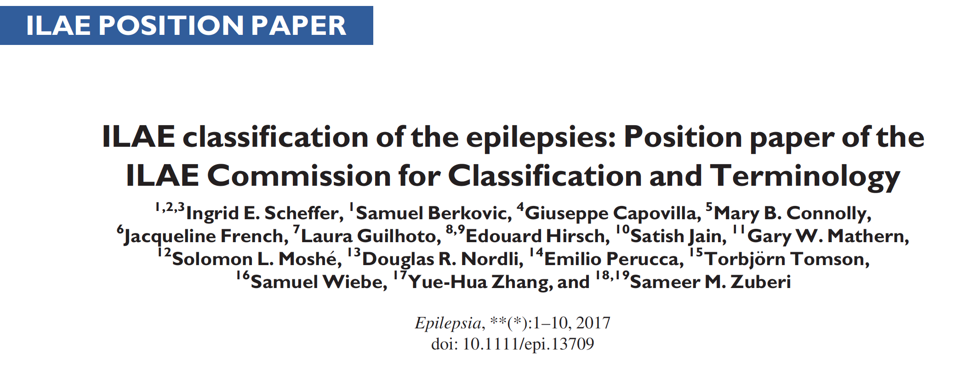
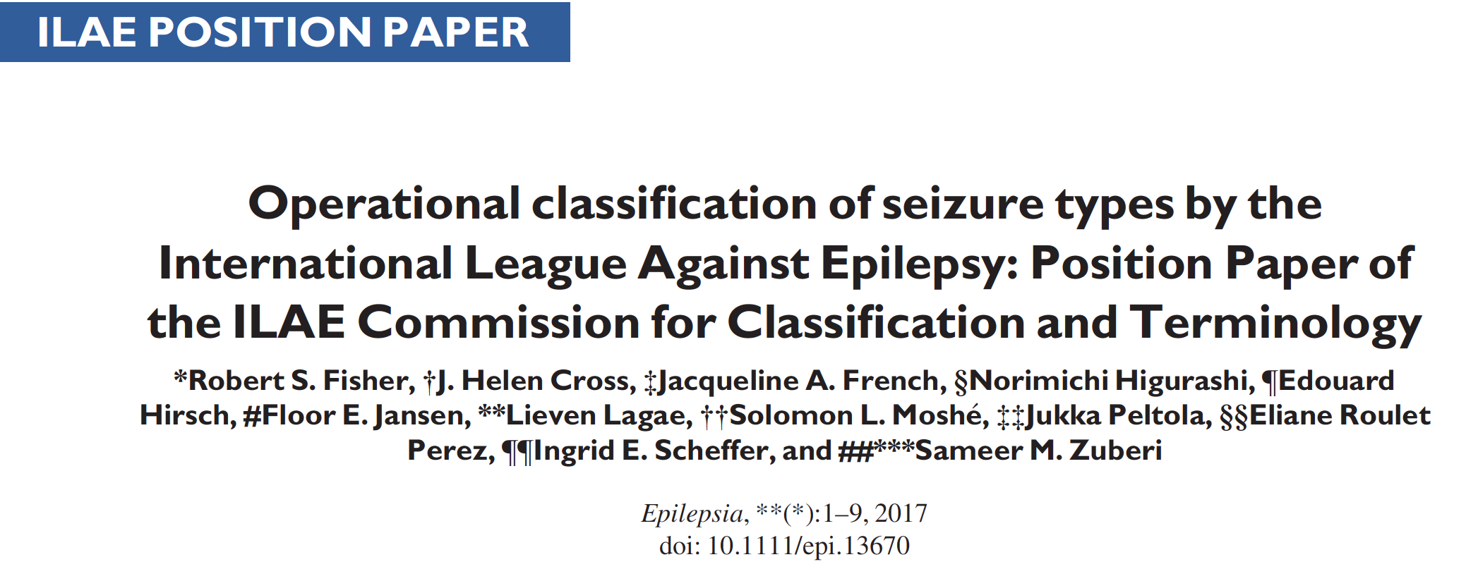

Slide 2
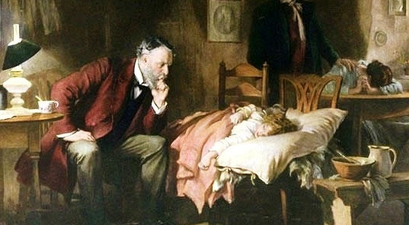
Classification of the Epilepsies
Purpose: for clinical diagnosis
Transparent language: use words that mean what they say
Notes:
Use words that mean what they say!!
Target audience – not epileptologists
GPs, medical students, paediatricians, neurologists, internists, psychiatrists, health workers, nurses, etc
> 80% of medical population

Slide 3
Co-morbidities
Seizure types
Etiology
Focal
onset
Generalized onset
Unknown onset
Structural
Genetic
Epilepsy types
Infectious
Focal
Generalized
Combined
Generalized
& Focal
Unknown
Focal
Metabolic
Immune
Unknown
Epilepsy Syndromes

Slide 4
1. Seizure types
Certain that events are epileptic seizures – not referring to distinguishing epileptic versus non-epileptic
In some settings → classification according to seizure type may be maximum level of diagnosis possible
In other cases → simply too little information to be able to make a higher level diagnosis
  eg. when a patient has only had a single event

Slide 5
Seizure types
Focal
onset
Generalized onset
Unknown onset

Slide 6
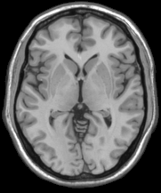
Generalized seizures
Originate at some point within and rapidly engage bilaterally distributed networks
Can include cortical and subcortical structures
but not necessarily the entire cortex
Notes:
Here is a diagram that shows a conceptual network for generalized seizures involving the corticothalamic circuitry. Theoretically a generalized seizure could start at different points in the network and engage bilaterally distributed networks. Thus a seizure could start frontally or even parietally.The key point is that a generalized seizure can start from a focal point.
6

Slide 7
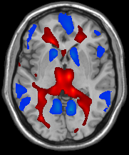
Notes:
Conceptual diagram with fMRI of GSW network
7

Slide 8
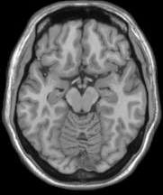
Focal seizures
  Originate within networks limited to one hemisphere
  May be discretely localized
  or more widely distributed.…
Notes:
8

Slide 9
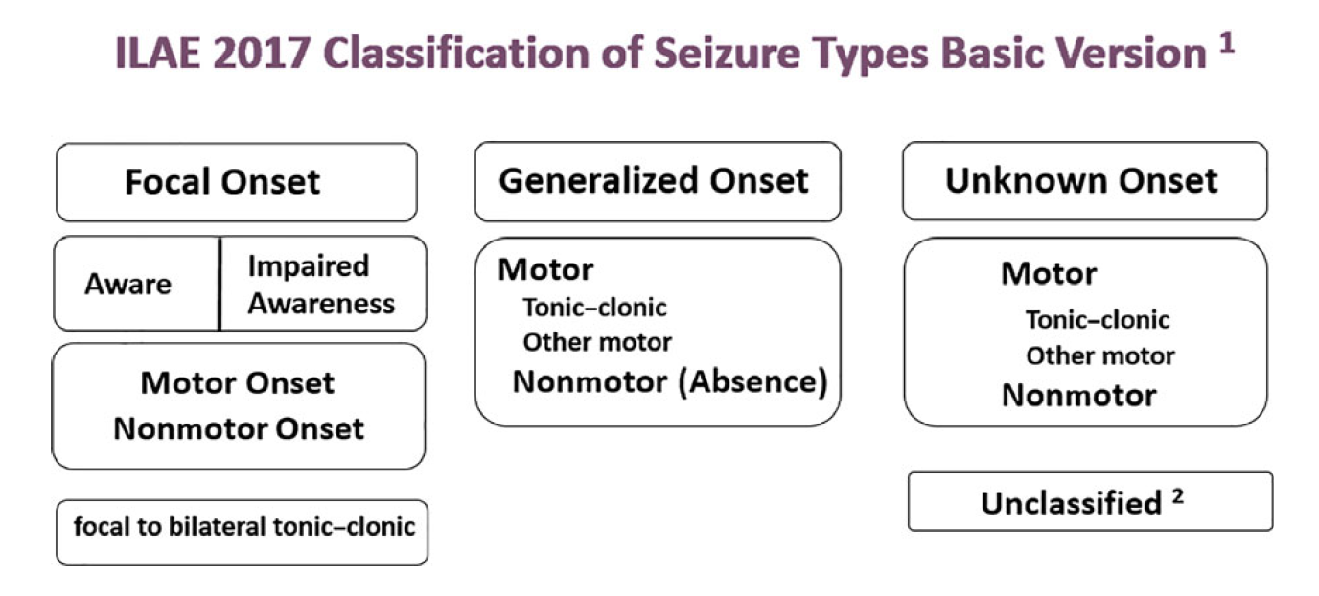
Notes:
Awareness means person is aware of self and envt through sz even if immobile. Earliest prominent feature defines the sz type which might then progress to other signs and sx
Impaired awareness at any time during a focal onset sz renders it a FIAS
Specific motor and non motor classifiers can be added.

Slide 10
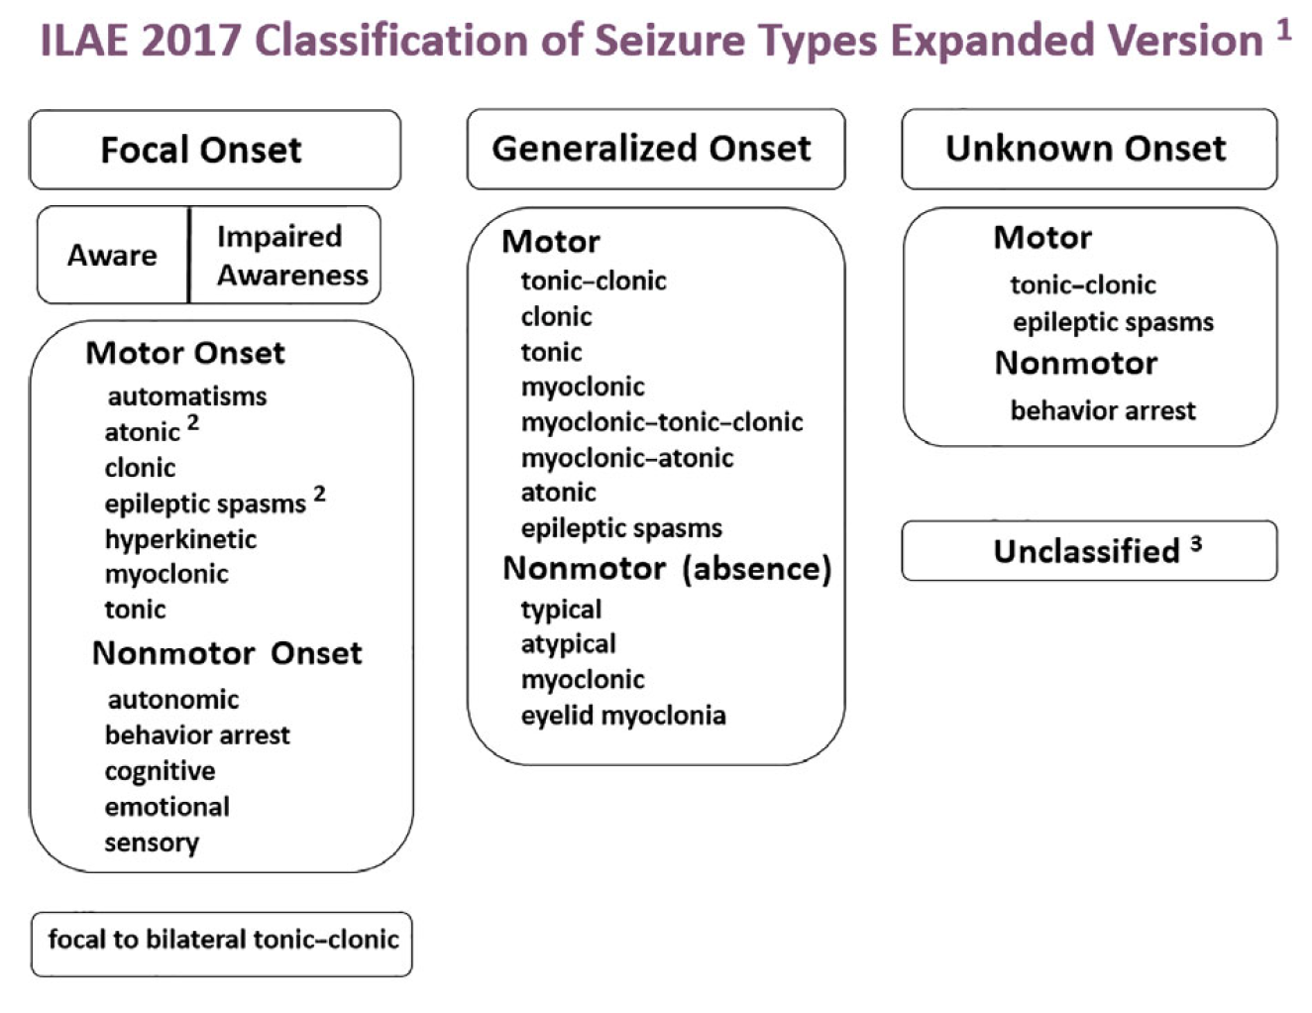
Notes
Atonic seizures and epileptic spasms would not have level of awareness specified
Pedalling grouped in hyperkinetic rather than automatisms (arbitrary)
Cognitive seizures
  impaired language
  other cognitive domains
  positive features eg déjà vu, hallucinations, perceptual distortions
Emotional seizures: anxiety, fear, joy, etc
Notes:
Classify aware or impaired awareness at any time during the sz
then optionally add motor or non motor onset feature reflecting earliest motor or non motor sign or symptom other than awareness
In some settings may not want to comment on awareness eg neonate so can omit this and classify by earliest motor or non motor feature
Free text can be added to characterise sz

Slide 11
Notes:
Classify aware or impaired awareness at any time during the sz
then optionally add motor or non motor onset feature reflecting earliest motor or non motor sign or symptom other than awareness
In some settings may not want to comment on awareness eg neonate so can skip this
Free text can be added to characterise sz

Slide 12
Notes:
Classify aware or impaired awareness at any time during the sz
then optionally add motor or non motor onset feature reflecting earliest motor or non motor sign or symptom other than awareness
In some settings may not want to comment on awareness eg neonate so can skip this
Free text can be added to characterise sz

Slide 13
Note
When a seizure type begins with ”focal, generalized or absence” then the word “onset” can be presumed
Notes:
Free text can be added to characterise sz

Slide 14
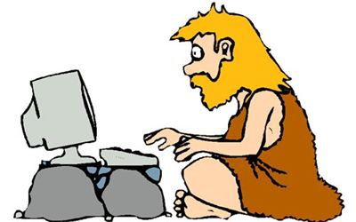
Terms no longer in use
Complex partial
Simple partial
Partial
Psychic
Dyscognitive
Secondarily generalized tonic-clonic

Slide 15
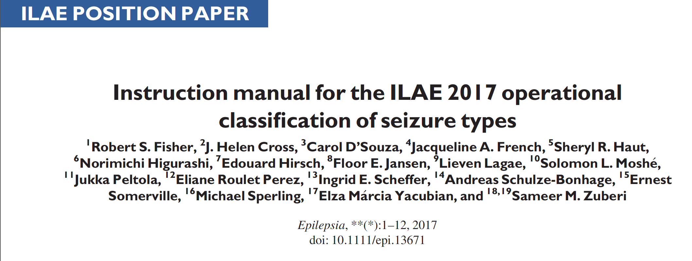

Slide 16
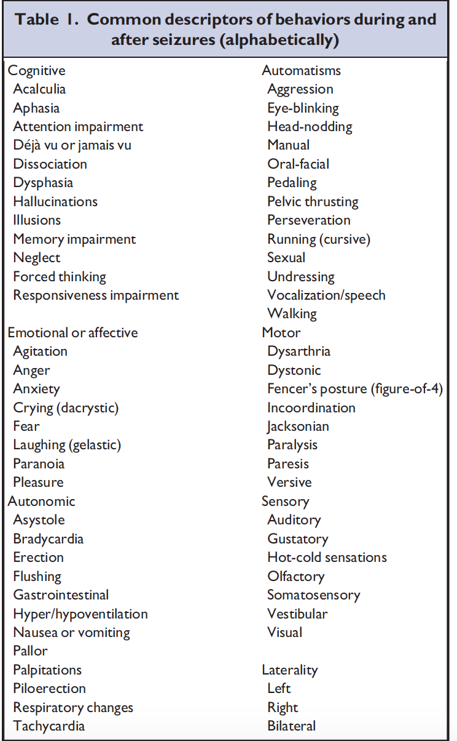
Note
Clarify features of seizures but do not define unique seizure types
Free text descriptors encouraged
Notes:
Laterality is an important descriptor

Slide 17
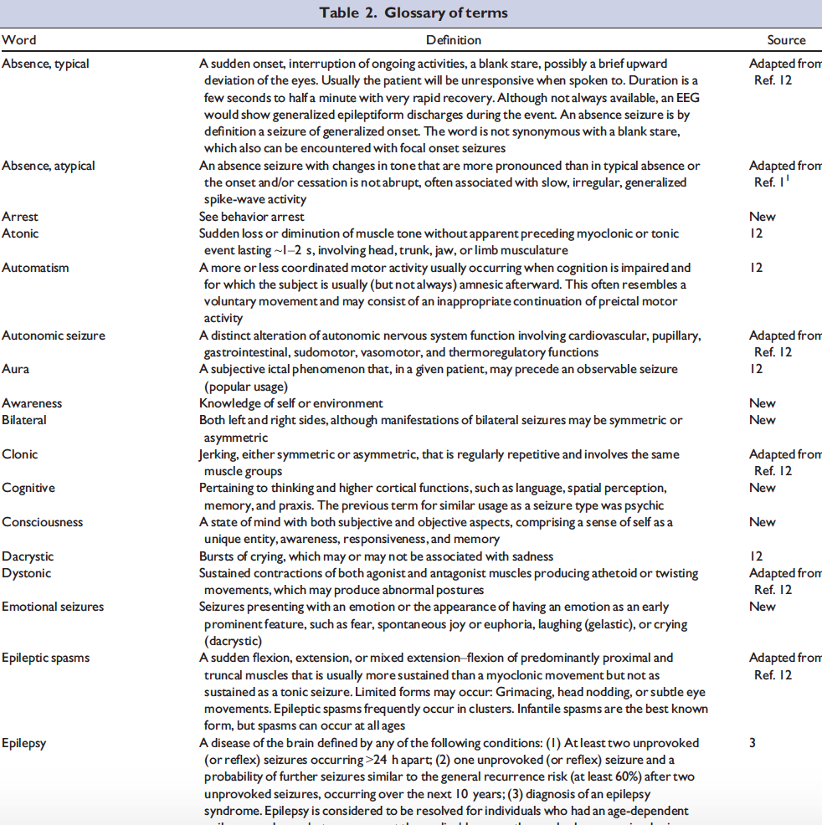
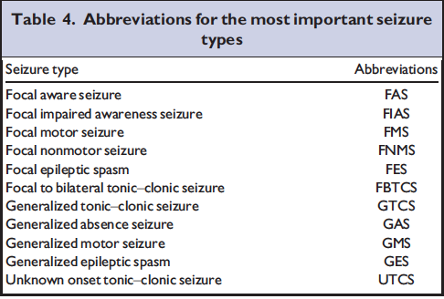
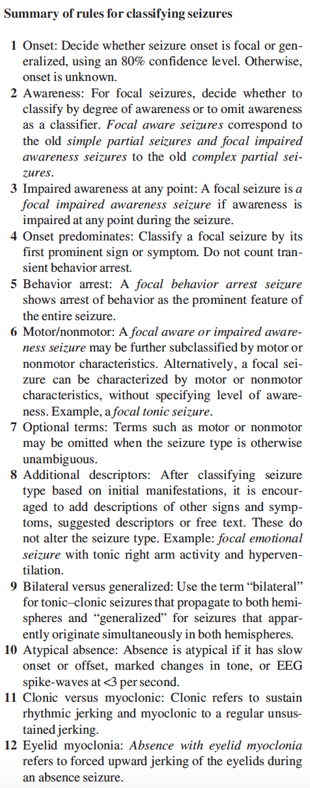
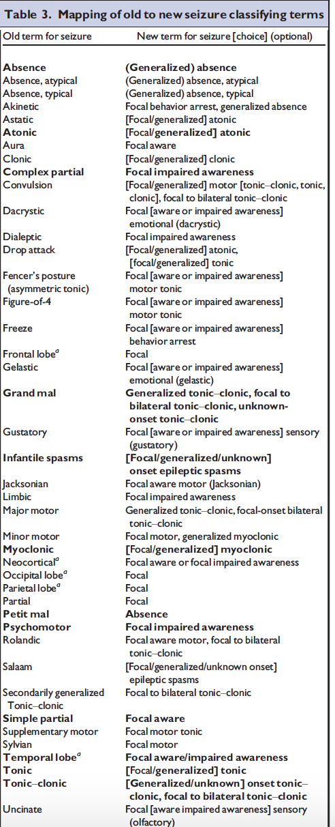

Slide 18
Seizure types
Etiology
Focal
onset
Generalized onset
Unknown onset
Structural
Genetic
Tuberous Sclerosis
Infectious
Metabolic
Immune
GLUT1 deficiency
Unknown

Slide 19
Epilepsy types
Focal
Generalized
Combined
Generalized
& Focal
Unknown
Focal
Where unable to make an Epilepsy Syndrome diagnosis or a diagnosis of Etiology
Many examples
  Temporal lobe epilepsy
  Generalized tonic-clonic seizures in a 5 year old with generalized spike-wave
  Both focal impaired awareness seizures and absence seizures in a patient
  Cannot tell if tonic-clonic seizure is focal or generalized
Notes:
Often a diagnosis regarding the type of epilepsy can be made (level 2: epilepsy classified by seizure type) and clinicians should strive to make a diagnosis at this level wherever possible. Added categories of “generalized and focal epilepsy” and “unknown if generalized or focal epilepsy”

Slide 20
Generalized and Focal Epilepsies
Combined focal and generalized epilepsies
  Examples
  Dravet syndrome
What do with
  Multifocal epilepsies?
  Hemispheric epilepsies?
→ focal
→ focal
Notes:
Increasingly observed in clinical practice
Previously incorrectly allocated to unknown

Slide 21
Seizure types
Etiology
Focal
onset
Generalized onset
Unknown onset
Structural
Genetic
Epilepsy types
Infectious
Focal
Generalized
Combined
Generalized
& Focal
Unknown
Focal
Metabolic
Immune
Unknown
Epilepsy Syndromes

Slide 22
Old term
‘Idiopathic Generalized Epilepsies’
Idiopathic Generalized Epilepsies
Childhood
Absence
Epilepsy
Juvenile
Absence
Epilepsy
Juvenile
Myoclonic
Epilepsy
Generalized
Tonic-Clonic
Seizures Alone

Slide 23
Genetic versus idiopathic
‘Idiopathic’ = presumed hereditary predisposition
Genetic ≠ inherited
  Importance of de novo mutations in both
  mild and severe epilepsies
Critical problem of stigma in some parts of the world

Slide 24
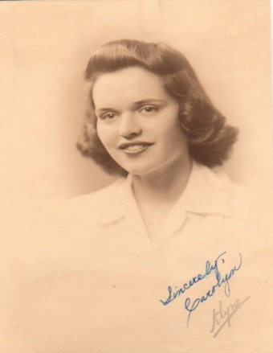
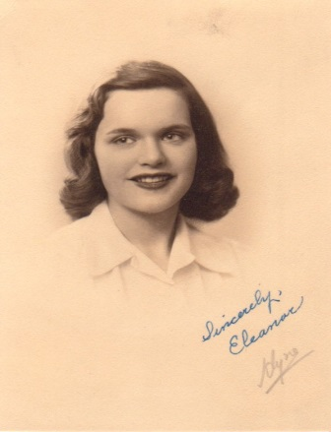
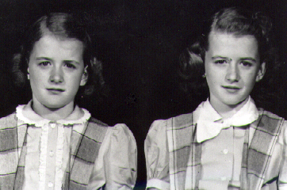
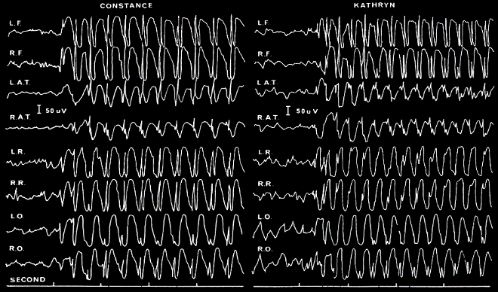
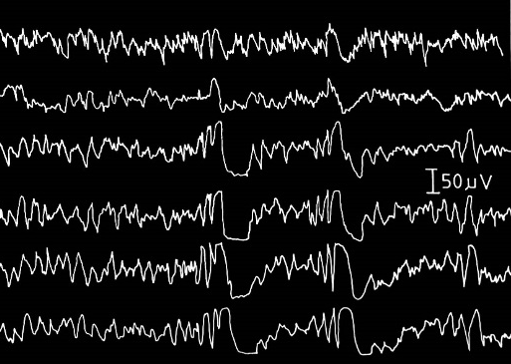
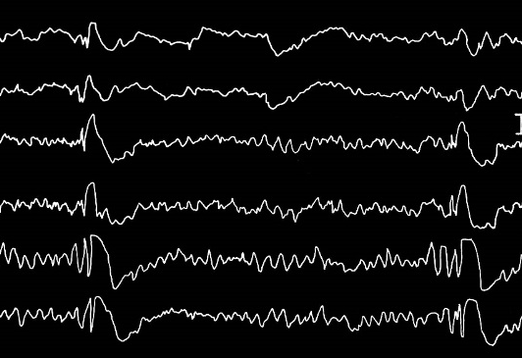
Genetic ≠ Gene testing
  Usually the mutation is not known
  Access to molecular genetic testing not necessary
  Diagnosed on clinical research eg. twin, family studies
JME pair; Lennox 1941
CAE pair; Lennox 1950

Slide 25
Co-morbidities
Seizure types
Etiology
Focal
onset
Generalized onset
Unknown onset
Structural
Genetic
Genetic
Epilepsy types
Infectious
Generalized
Focal
Generalized
Combined
Generalized
& Focal
Unknown
Focal
Metabolic
Immune
Unknown
Epilepsy Syndromes

Slide 26
Epilepsy syndromes
There are no approved ILAE epilepsy syndromes

Slide 27
https://www.epilepsydiagnosis.org

Slide 32
Benign
Many epilepsies not benign
  CAE – psychosocial impact
  BECTS – learning concerns
Replaced by terms:
  Self-limited
  Pharmacoresponsive
No longer use
  Malignant
  Catastrophic

Slide 33
Developmental and/or Epileptic encephalopathies
Epileptic activity itself
contributes to severe cognitive and behavioral impairment above and beyond that expected from the underlying pathology and that these can worsen over time
Berg et al 2010

Slide 34
Developmental and/or Epileptic Encephalopathy
For many encephalopathies, there is a developmental component independent of the epileptic encephalopathy
Developmental delay may precede seizure onset
Co-morbidities
eg. cerebral palsy, autism spectrum disorder, intellectual disability
Outcome poor even though seizures stop
eg. KCNQ2, STXBP1 encephalopathies

Slide 35
Developmental and/or Epileptic Encephalopathy
Developmental encephalopathy
  May begin in utero
  Post birth
Epileptic encephalopathy
  Can occur at any age
  May have remediable component – right vs wrong AED
Move towards GENE encephalopathy
  eg. CDKL5 encephalopathy, SCN2A encephalopathy

Slide 36
Old terms
‘Symptomatic Generalized Epilepsies’
Used for two different groups of disorders
Symptomatic Generalized Epilepsies
Developmental
and/or
Epileptic
Encephalopathies
(Static)
Encephalopathies

Slide 37
ILAE Classification of the Epilepsies
Simplified the framework
Etiology – consider at all stages
Developmental and/or Epileptic Encephalopathies
Self-limited, pharmacoresponsive
Genetic Generalized Epilepsies
  Idiopathic Generalized Epilepsies = CAE, JAE, JME, GTCA
Symptomatic Generalized Epiliepsies used for both
→ Developmental and Epileptic Encephalopathies
→ (static) Encephalopathy with Epilepsy

Slide 38
Impact on Clinical Care and Practice
New classification framework will
  Change the approach to diagnosis in the clinic
  Be applied to patients and guide management
Updates terminology to reflect
current thinking
  Scientific advances

Slide 39


ILAE Classification Task Force 2013-7
Torbjörn Tomson, Emilio Perucca, Ingrid Scheffer, Jackie French, Yue-Hua Zhang
Satish Jain, Gary Mathern, Sam Wiebe, Edouard Hirsch, Sameer Zuberi, Nico Moshe

